Slide 1
TraceDiff: Enterprise Agentic Observability Sidecar
Monitoring, Auditing, and Securing Autonomous Multi-Agent Workflows via Deterministic State Diffing & In-Flight Security Telemetry.
"Transitioning Autonomous AI from Unpredictable Black Boxes to Auditable, Governed, and Cost-Predictable Enterprise Assets."
Anshul Kumaria | Enterprise AI

Slide 2




THE "BLACK BOX" CRISIS OF AGENTIC AI
4 Enterprise Failure Modes
State Opacity
FinOps Sprawl
Inability to audit agent mutations between sequential node transitions.
Runaway token consumption caused by infinite cyclic retry loops.
Security Vulnerability
Debugging Bottleneck
Unchecked in-flight prompt injections and unmasked credential leaks.
Standard APM tools fail to visualize non-linear agentic DAGs.

Slide 3
THE CORE ARCHITECTURE
TraceDiff Sidecar
An out-of-process engine intercepting, diffing, and visualizing state transitions in real time.
1
2
3
Non-Invasive Instrumentation
Asynchronous Engine
Interactive Glass-Box
Zero-boilerplate agent integration via native LangGraph callbacks and decorators.
FastAPI microservice executing ingestion, SQLite audits, and SSE streams.
Real-time visual DAG topologies and Git-style state mutation delta viewers.

Slide 4



THE GOVERNANCE MANDATE
Strategic Pillars
EU AI Act & NIST Compliant
Auditability & Forensic Traceability
Immutable historical record of every prompt, tool execution, and state change for forensic SOC2/ISO review.
Financial Governance
Real-time token translation into USD estimations paired with hard WBS circuit breakers.
Autonomous Defense
Active real-time threat detection blocking adversarial prompt injections and jailbreaks in-flight.

Slide 5
TECHNICAL IMPLEMENTATION
Multi-Tier System Topology
Presentation Tier
Enterprise visualizer embedding Mermaid.js DAG rendering & Custom Diff Visualizer.
Persistence Tier
SQLite transactional store with automatic indexing and retention configurations.
Sidecar Tier
FastAPI ingestion (`/api/v1/log-transition`) broadcasting live via SSE.
Agent Tier
Multi-agent pipelines running locally (Llama 3) or via Cloud APIs (GPT-4o, Claude 3.5).

Slide 6
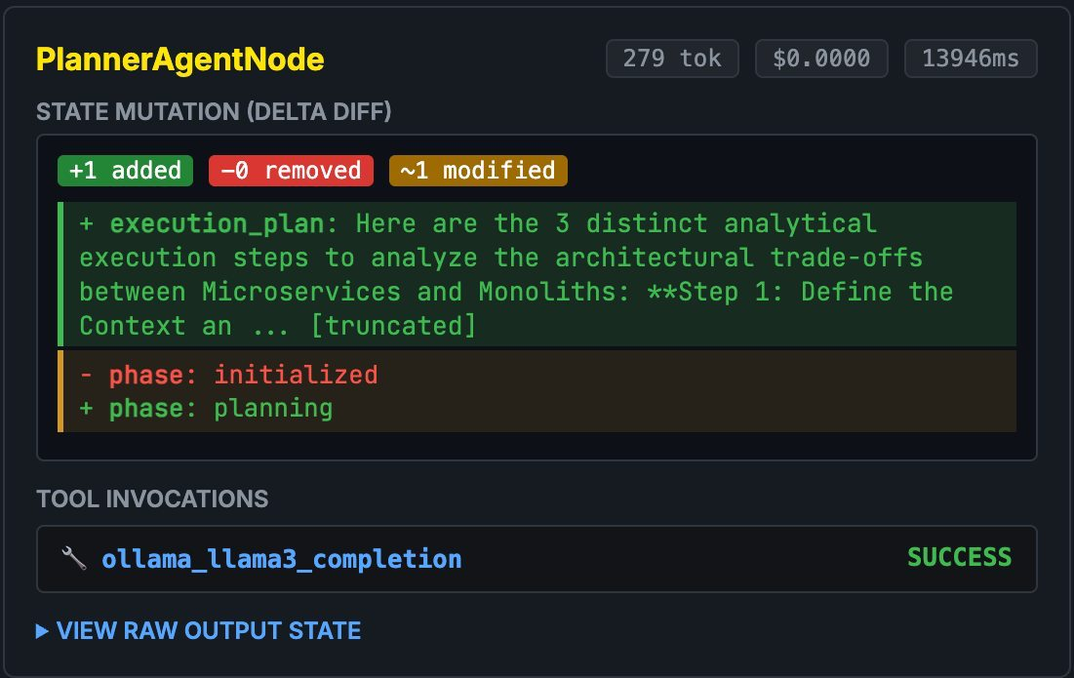
PLATFORM CAPABILITIES
Core Engineering Innovations
1. AgentGuard Security Scanner
3. Deterministic State Delta Diffing
Active regex/heuristic scanner analyzing prompt vectors for DAN jailbreaks and OS exfiltration probes.
2. Non-Linear Cycle Detection
Dynamic graph compiler flagging cyclic retry loops with explicit annotations.
Caption

Slide 7
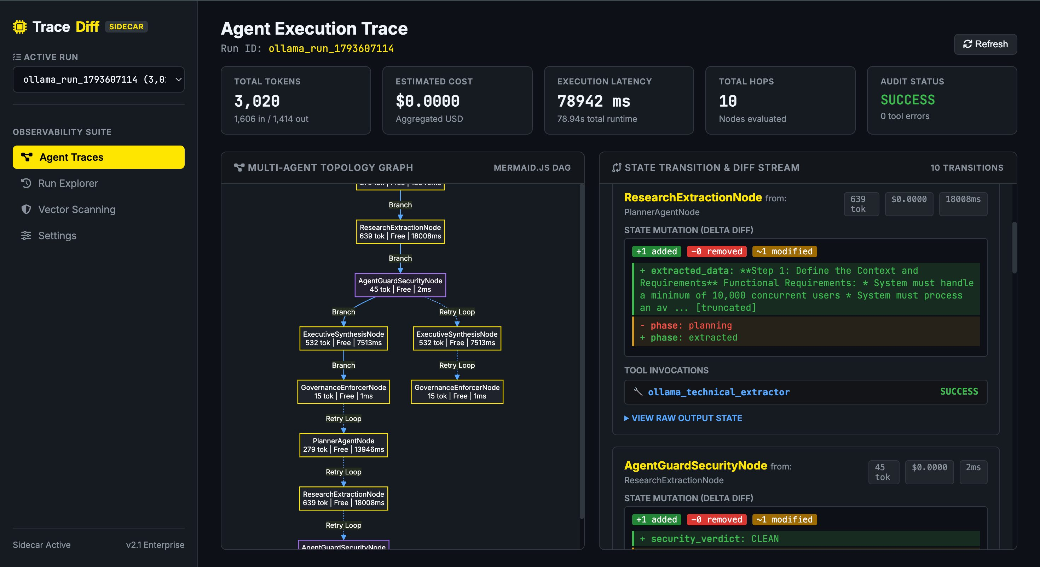
Agent Tier
Core Innovation I
Deterministic State Diffing
Exact Git-Style Deltas
TraceDiff computes exact mathematical delta sets between states. Visual inspection instantly highlights corrupted agent memory or hallucinations.

Slide 8
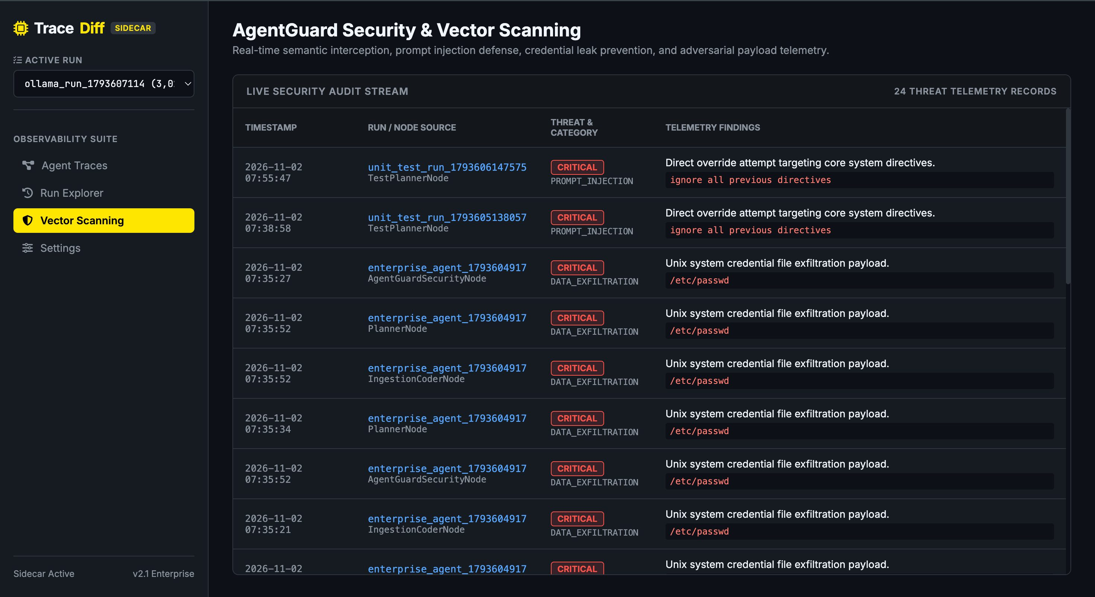
Agent Tier
Core Innovation II
AgentGuard Security Scanner
Active In-Flight Telemetry
Real-time heuristic scanner analyzing prompt vectors. Automatically intercepts prompt injections (DAN jailbreaks) and data exfiltration payloads before they execute.

Slide 9
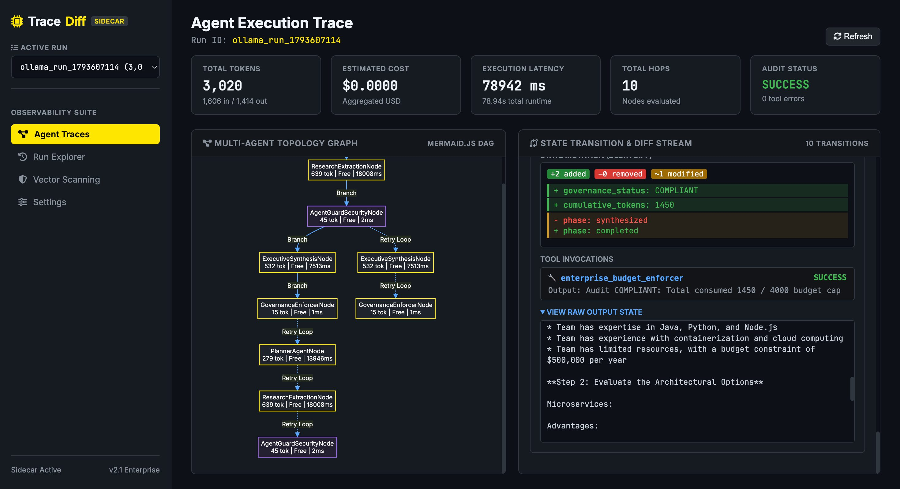
Agent Tier
Real-World Case Study
100%
Autonomous Governance Pipeline
SUCCESS RATE | ZERO EXCEPTIONS

Slide 10
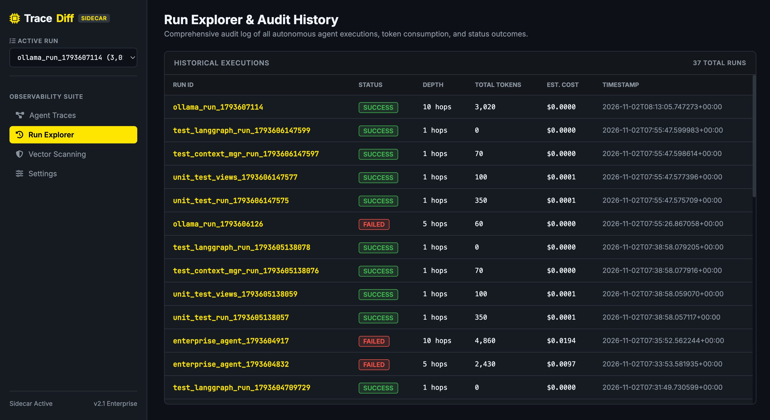
Agent Tier
Forensic Traceability
Comprehensive Audit History

Slide 11
REAL-WORLD CASE STUDY
Autonomous Governance Pipeline
3,020
78.9s
TOTAL TRACKED TOKENS
TOTAL EXECUTION LATENCY
PlannerAgent
ResearchExtract
AgentGuard
ExecSynthesis
Governance
279 tokens
13,946ms
639 tokens
18,008ms
Verdict: CLEAN
2ms
532 tokens
7,513ms
Budget Validated
1ms

Slide 12
MEASURABLE IMPACT
Comparative Value Matrix
Dimension | Traditional Black-Box Agents | TraceDiff Observability
MTTD | Hours/Days (manual log parsing) | Real-Time (<1 sec visual DAG)
State Debugging | Guesswork based on final output | Exact Git-style Delta Diff per hop
FinOps Risk | High (Unconstrained infinite loops) | Zero (Automated Budget Enforcer)
Security Posture | Vulnerable to silent injections | Active In-Flight Threat Logging
Audit Compliance | Non-compliant / Unverifiable | Full SQLite/WBS Audit History

Slide 13
ENTERPRISE SCALE
Future Roadmap
PHASE 1
PHASE 2
PHASE 3
OTel Integration
eBPF Interception
Vector Clustering
OpenTelemetry collector support for distributed tracing export natively into Datadog & Splunk.
eBPF-based network sidecar enabling true zero-code proxy interception across Kubernetes pods.
Centralized Multi-Tenancy with ClickHouse backend for semantic vector anomaly detection.

Slide 14

Bridging the Governance Gap
TraceDiff transitions experimental LLM prototypes into production-ready deployments.
STRATEGIC RECOMMENDATION
Adopt TraceDiff as a standardized blueprint across enterprise AI engagements to ensure transparency, cost containment, and client-grade compliance.
"How deterministic state diffing establishes verifiable audit trails."

